Slide 1
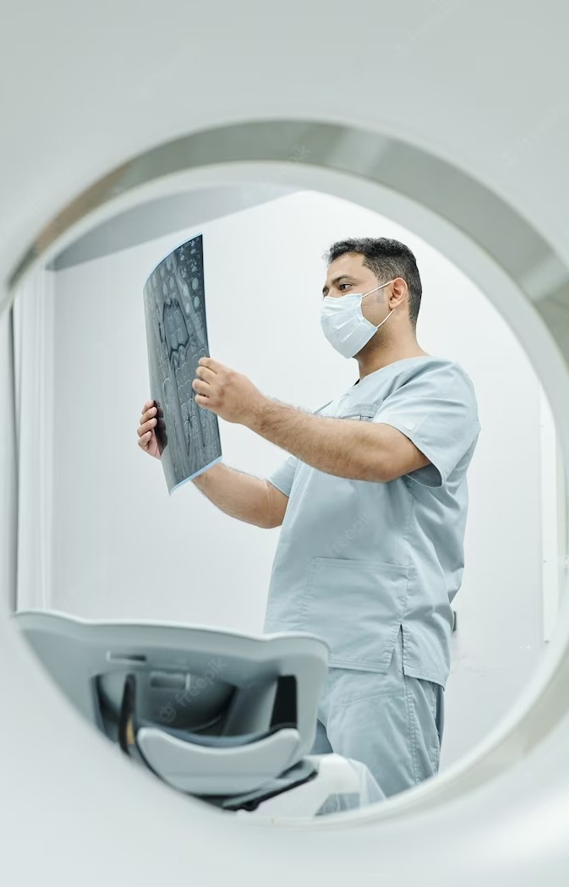

FINAL PROJECT Revolutionizing Medical Image Analysis through Deep Learning Technology Student Name: Meghana Ramireddy Student ID: 811246082 Mail ID: mramired@kent.edu

Slide 2
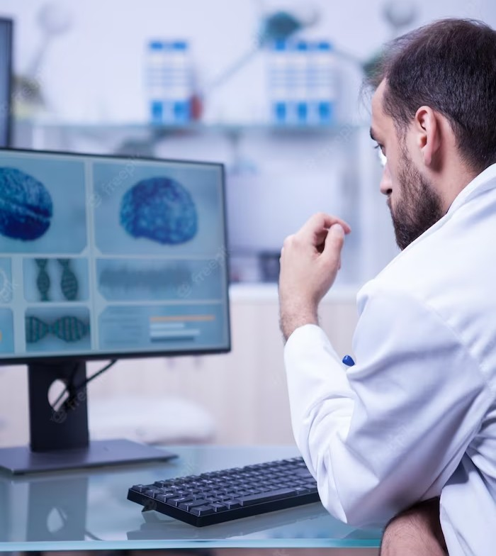
INTRODUCTION
In order to accurately diagnose, plan treatments for, and monitor numerous diseases, medical image analysis is essential in the healthcare industry. Deep learning has advanced significantly in this subject in recent years and has established itself as an efficient technique. This section highlights the cutting-edge deep learning models and algorithms used in medical image processing, along with their efficacy and potential consequences.

Slide 3

Deep Learning Models
CNNs
Convolutional Neural Networks (CNNs) have been instrumental in image-based
RNNs
Recurrent Neural Networks (RNNs) and attention mechanisms have shown promise in sequential data analysis
GANs & Attention Mechanisms
Generative Adversial Network and data augmentation addess the
challenge of limited annotated data

Slide 4
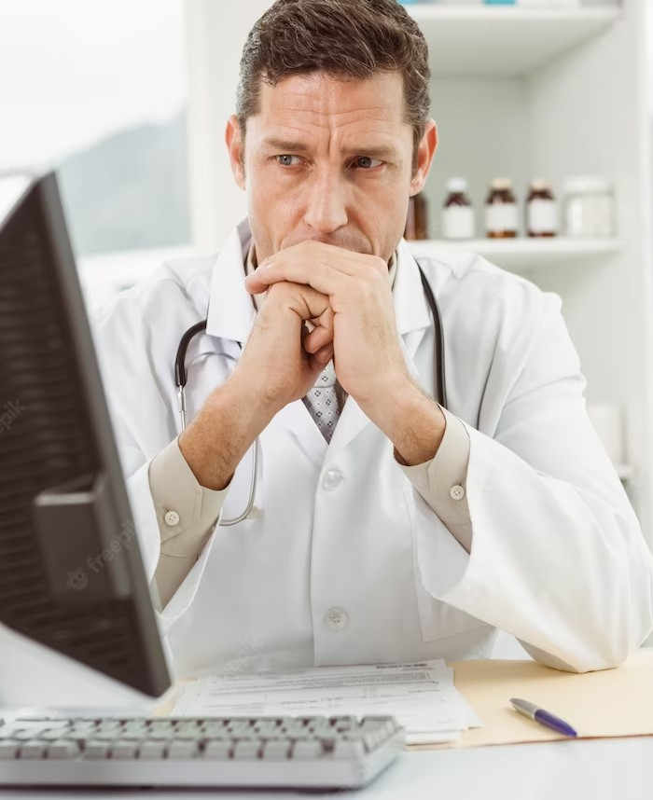
Effectiveness of Deep Learning in Medical Image Analysis:
Medical Image Classiﬁcation: Deep learning models have been successful in classifying medical images into diIerent categories, enabling automated diagnosis and triage. CNN-based
models have achieved state-of-the-art results in classifying skin lesions for early detection of melanoma.
·Disease Detection and Diagnosis: Deep learning models have shown impressive results in detecting various diseases, including cancer, cardiovascular conditions, and neurological disorders. For instance, CNN-based models have achieved high sensitivity and speciﬁcity in detecting breast cancer from mammograms.
·Segmentation and Localization: Deep learning-based
segmentation algorithms provide accurate delineation of anatomical structures and lesions, aiding treatment planning and surgical interventions. U-Net architecture has been widely used for accurate segmentation of organs and tumors from medical images.
·Image Registration and Reconstruction: Deep learning technique improved image registration accuracy and reconstruction quality, facilitating multi-modal imaging and image-guided interventions.

Slide 5
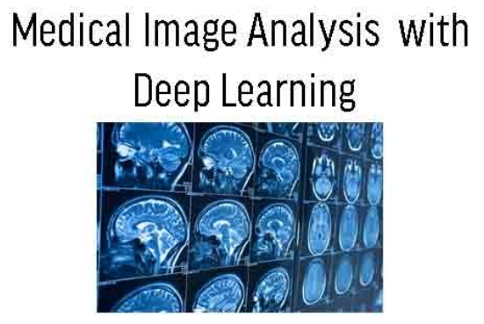
Current Challenges and Limitations:
Ethical Considerations: Deep learning in medical image analysis raises ethical concerns regarding patient privacy, data ownership, and potential biases in decision-making.
Limited Annotated Data: Deep learning models often require large annotated datasets, which can be challenging to acquire in the medical domain due to the need for e pert annotations and patient privacy concerns.
Interpretability and Explainability: Deep learning models are often considered boxes, making it difficult to interpret their black decisions and provide explanations to clinicians.
Generalization to New Populations: Models trained on data from one population may not generalize well to diverse patient populations, leading to biases and reduced performance.

Slide 6
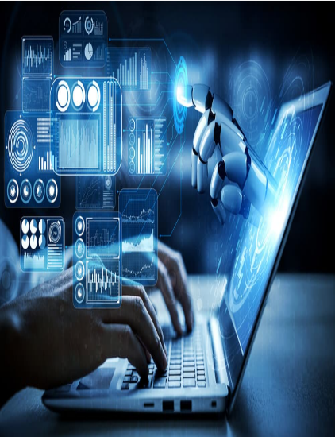
CURRENT AND POTIENTIAL ADVANCEMENTS AND APPLICIAITONS
HealthCare:
Medical image analysis
Clinical decision report
Drug discovery
Disease risk assessment
Telemedicine
2. Transportation:
Autonomous vehicles
Traffic management
Object decision and tracking
Natural Language Processing
3. Security:
Facial Recognition
Video surveillance
Threat Detection
Cyber security
Fraud detection

Slide 7
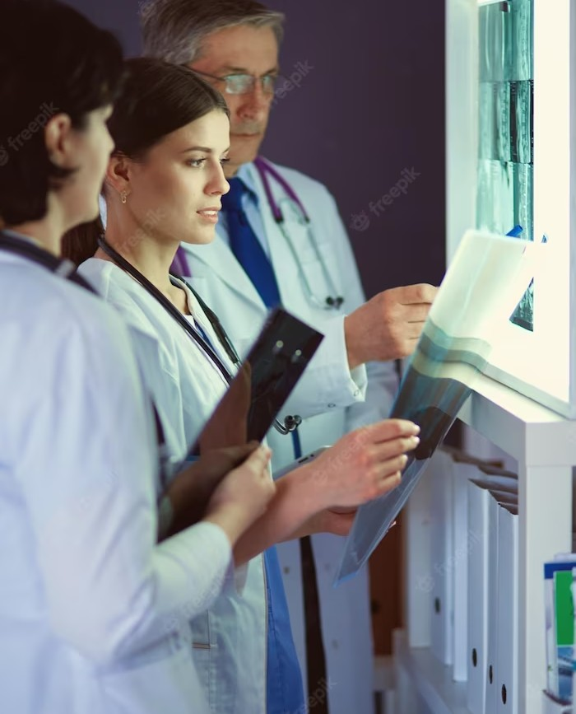
Potential Solutions and Future Developments:
Transfer Learning and Pretraining: Transfer learning and pretrained models can address the data scarcity issue by leveraging knowledge from related domains or pretraining on large publicly available datasets.
Explainable AI and Interpretable Models: Research in interpretable deep learning models aims to improve transparency, allowing clinicians to understand and trust the decision-making process.
Data Augmentation and Synthesis: Techniques like generative models and data augmentation can generate synthetic data to alleviate the scarcity of labeled medical images.
Federated Learning and Privacy-Preserving
Method of Multimodal Learning and Fusion

Slide 8
Conclusion
The recent advancements in deep learning models for medical image analysis have signiﬁcantly impacted healthcare. While challenges and limitations exist, ongoing research and future developments offer solutions to address these issues. With continued innovation and collaboration between deep learning researchers and healthcare professionals, the potential for improving medical diagnosis, treatment planning, and patient care is vast.

Slide 9
Thank You !

